Slide 1

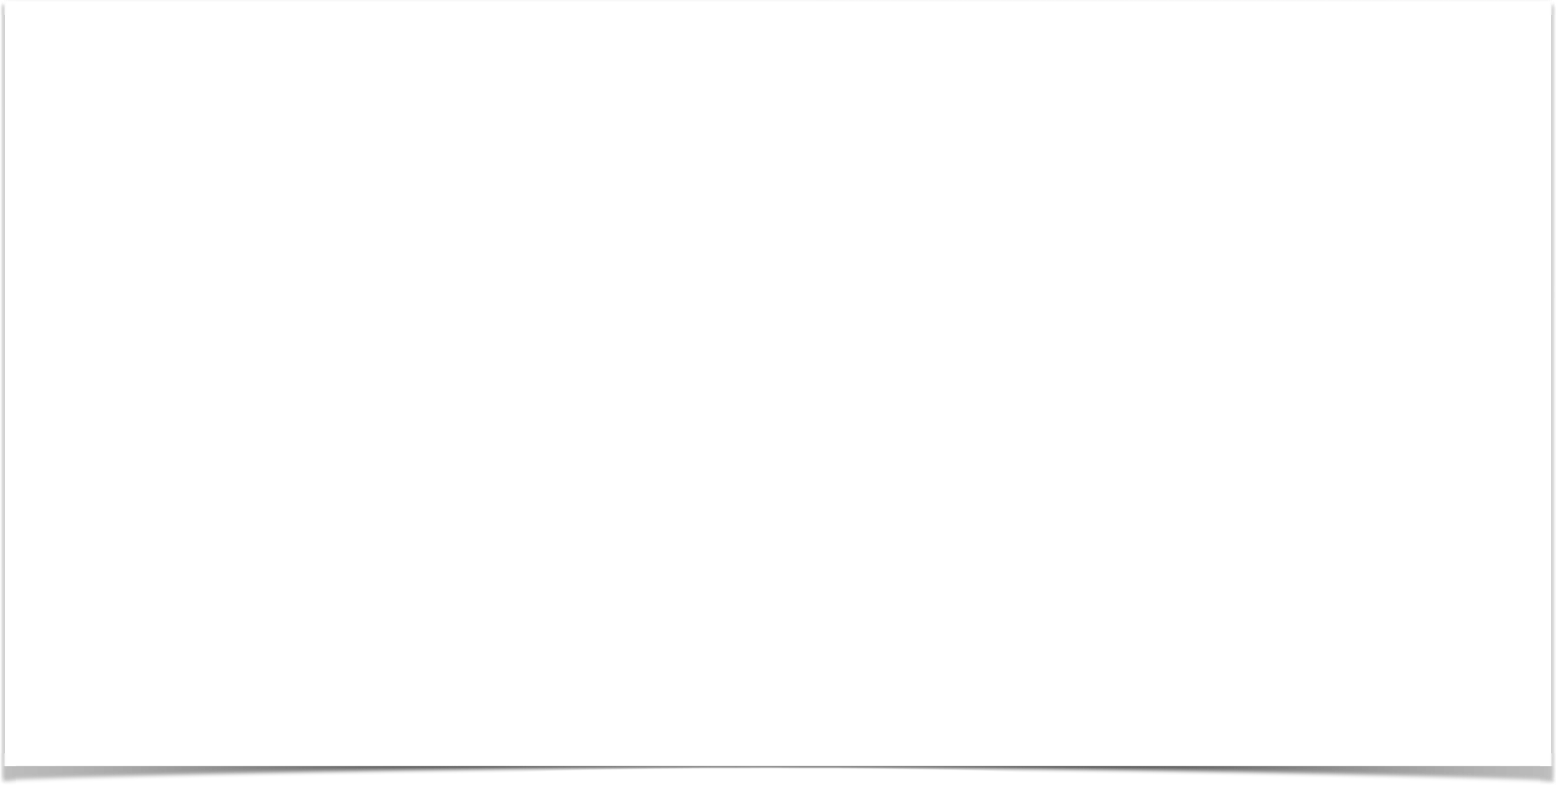

SPRING MVC OVERVIEW
Date

Slide 2
What is Spring MVC?
•
Framework for building web applications in Java
•
Based on Model-View-Controller design pattern
•
Leverages features of the Core Spring Framework (IoC, DI)
www.luv2code.com

Slide 3




Model-View-Controller (MVC)
Front Controller
Model
Web Browser
Controller
Model
View Template
www.luv2code.com

Slide 4
Spring MVC Benefits
•
The Spring way of building web app UIs in Java
•
Leverage a set of reusable UI components
•
Help manage application state for web requests
•
Process form data: validation, conversion etc
•
Flexible configuration for the view layer
www.luv2code.com

Slide 5
Spring MVC Behind the Scenes
Date

Slide 6


Components of a Spring MVC Application
Web Pages
•
A set of web pages to layout UI components
•
A collection of Spring beans (controllers, services, etc…)
Beans
•
Spring configuration (XML, Annotations or Java)
Spring Configuration
www.luv2code.com

Slide 7
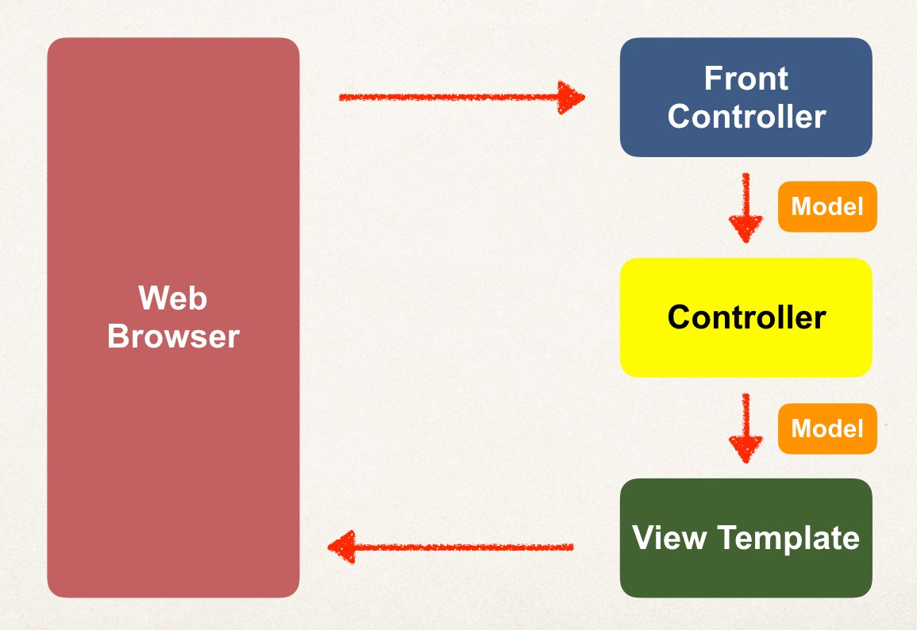
How Spring MVC Works Behind the Scenes
www.luv2code.com

Slide 8
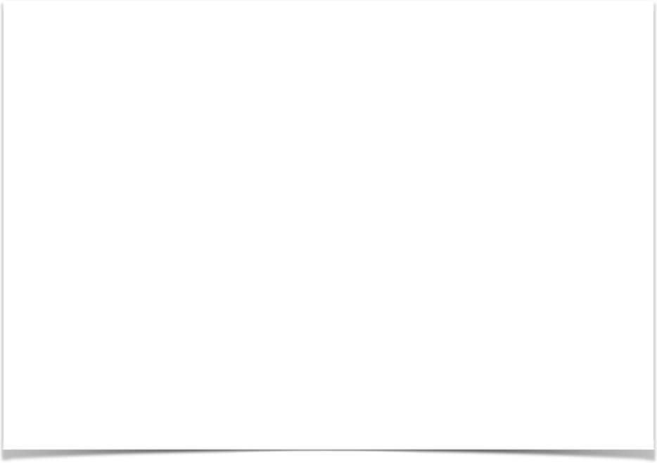
Spring MVC Front Controller
•
Front controller known as DispatcherServlet
Part of the Spring Framework
Already developed by Spring Dev Team
•
You will create
Model objects (orange)
View templates (dark green)
Controller classes (yellow)
www.luv2code.com

Slide 9

Controller
Code created by developer
•
Contains your business logic
Handle the request
Store/retrieve data (db, web service…)
Place data in model
•
Send to appropriate view template
www.luv2code.com

Slide 10
Model
•
Model: contains your data
•
Store/retrieve data via backend systems
•
database, web service, etc…
•
Use a Spring bean if you like
•
Place your data in the model
•
Data can be any Java object/collection
www.luv2code.com

Slide 11
View Template
Spring MVC is flexible
  Supports many view templates
•
Most common is JSP + JSTL
•
Developer creates a page
Displays data
JSP: Java Server Pages
JSTL: JSP Standard Tag Library
www.luv2code.com

Slide 12
View Template (more)
•
Other view templates supported
Thymeleaf, Groovy
Velocity, Freemarker, etc…
•
For details, see:
www.luv2code.com

Slide 13
SPRING MVC CONFIGURATION
Date

Slide 14
Spring MVC Configuration Process - Part 1
Add configurations to file: WEB-INF/web.xml
Configure Spring MVC Dispatcher Servlet
Set up URL mappings to Spring MVC Dispatcher Servlet
Step-By-Step
www.luv2code.com

Slide 15
Spring MVC Configuration Process - Part 2
Add configurations to file: WEB-INF/spring-mvc-demo-servlet.xml
Add support for Spring component scanning
Add support for conversion, formatting and validation
Configure Spring MVC View Resolver
Step-By-Step
www.luv2code.com

Slide 16

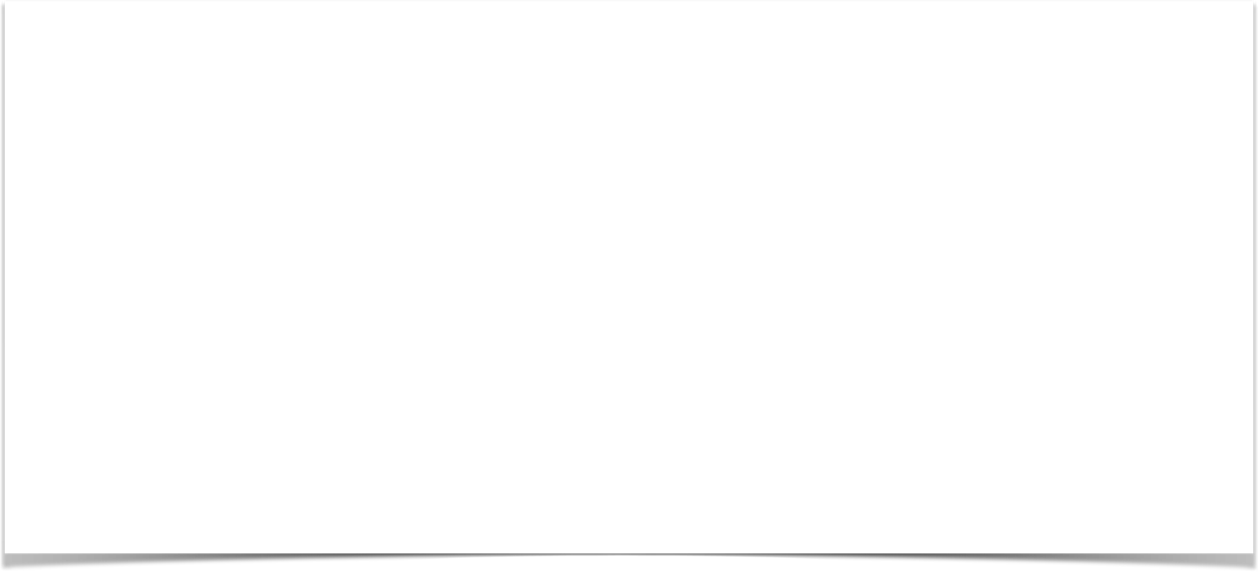
Step 1: Configure Spring DispatcherServlet
File: web.xml
<web-app>
<servlet>
<servlet-name>dispatcher</servlet-name>
<servlet-class>org.springframework.web.servlet.DispatcherServlet</servlet-class>
<init-param>
<param-name>contextConfigLocation</param-name>
<param-value>/WEB-INF/spring-mvc-demo-servlet.xml</param-value>
</init-param>
<load-on-startup>1</load-on-startup>
</servlet>
</web-app>
www.luv2code.com

Slide 17
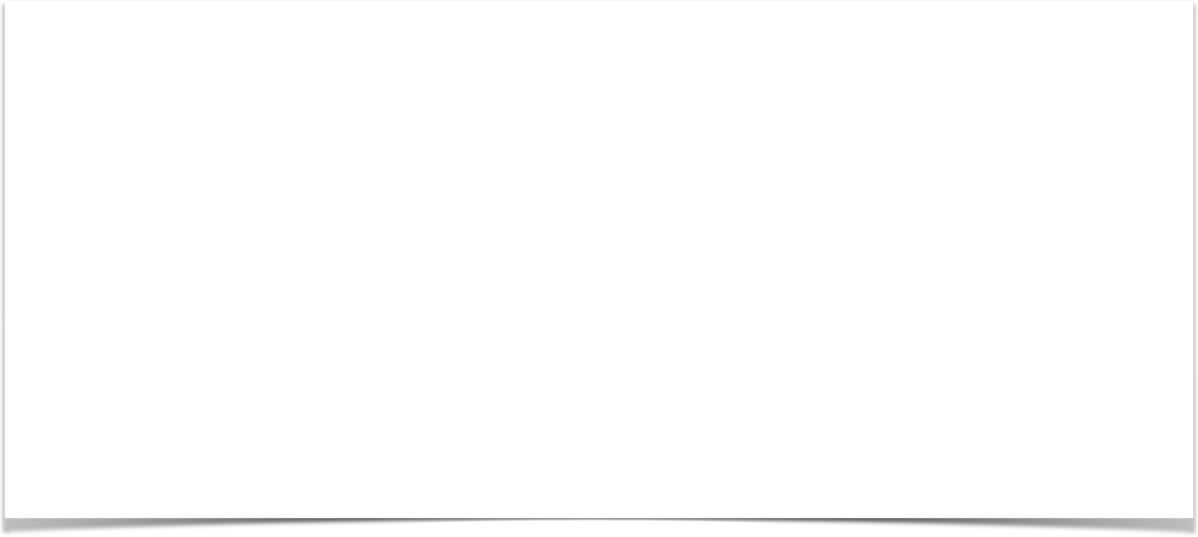

Step 2: Set up URL mappings to Spring MVC Dispatcher Servlet
File: web.xml
<web-app>
<servlet>
<servlet-name>dispatcher</servlet-name>
<servlet-class>org.springframework.web.servlet.DispatcherServlet</servlet-class>
...
</servlet>
<servlet-mapping>
<servlet-name>dispatcher</servlet-name>
<url-pattern>/</url-pattern>
</servlet-mapping>
</web-app>
www.luv2code.com

Slide 18

Step 3: Add support for Spring component scanning
File: spring-mvc-demo-servlet.xml
<beans>
<!-- Step 3: Add support for component scanning -->
<context:component-scan base-package="com.luv2code.springdemo" />
</beans>
www.luv2code.com

Slide 19

Step 4: Add support for conversion, formatting and validation
File: spring-mvc-demo-servlet.xml
<beans>
<!-- Step 3: Add support for component scanning -->
<context:component-scan base-package="com.luv2code.springdemo" />
<!-- Step 4: Add support for conversion, formatting and validation support -->
<mvc:annotation-driven/>
</beans>
www.luv2code.com

Slide 20
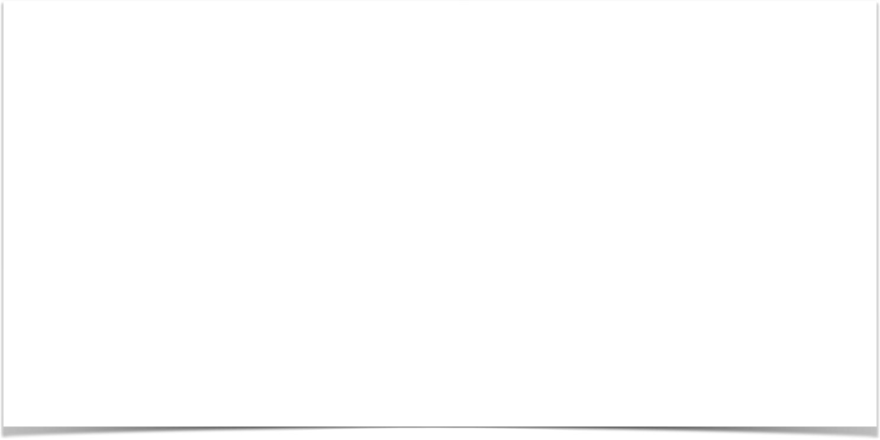
Step 5: Configure Spring MVC View Resolver
File: spring-mvc-demo-servlet.xml
<beans>
<!-- Step 3: Add support for component scanning -->
<context:component-scan base-package="com.luv2code.springdemo" />
<!-- Step 4: Add support for conversion, formatting and validation support -->
<mvc:annotation-driven/>
<!-- Step 5: Define Spring MVC view resolver -->
<bean
class="org.springframework.web.servlet.view.InternalResourceViewResolver">
<property name="prefix" value="/WEB-INF/view/" />
<property name="suffix" value=".jsp" />
</bean>
</beans>
www.luv2code.com

Slide 21
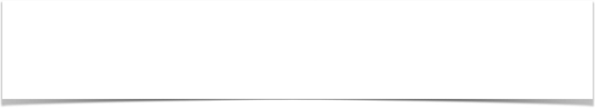
View Resolver Configs - Explained
When your app provides a “view” name, Spring MVC will
  prepend the prefix
  append the suffix
<bean
class="org.springframework.web.servlet.view.InternalResourceViewResolver">
<property name="prefix" value="/WEB-INF/view/" />
<property name="suffix" value=".jsp" />
</bean>
www.luv2code.com

Slide 22

View Resolver Configs - Explained
<bean
class="org.springframework.web.servlet.view.InternalResourceViewResolver">
<property name="prefix" value="/WEB-INF/view/" />
<property name="suffix" value=".jsp" />
</bean>
/WEB-INF/view/
show-student-list
.jsp
View name
www.luv2code.com

